Slide 1
Презентацию выполнила Новикова Лиза,ученица 11 класса средней школы №78 г.Ярославля.
Учитель Федорина О.В.

Slide 2
Hollywood is the capital of world movie production

Slide 3
This is Los Angeles, it is also called L.A. It's the second largest American city.
It is situated in the state of California. Its population is 3,598 000. It's one of the most beautiful and richest cities of America.

Slide 4
This is Hollywood. It is the suburb of Los Angeles.
Hollywood is the capital of world movie production. The biggest and most successful film studios- Disney, Universal, Fox, Warner Bros, Columbia- are here. These are star factories. A lot of famous stars have been through the gates of these studios.

Slide 5
Malibu is the most beautiful and glamorous city in America.
It is known for its beautiful beach. Here celebrities can look at the ocean from the windows of their multi-million-dollars homes.

Slide 6
Hollywood Walk of Fame
This is the Walk of Fame in Hollywood Boulevard. You can see there bronze stars set in the sidewalk and you can read the names of the people who made Hollywood famous : film directors, producers, camera operators, actors, actresses and musicians

Slide 7
The Walk of Fame is the most unusual monument to talent and success in the world. The tradition started in the late 1950s and now there are more than 2,500 stars in the sidewalk. Every year twenty new celebrities get their stars, but a star isn't cheap. It costs about 40,000 dollars to install and look after one.

Slide 8
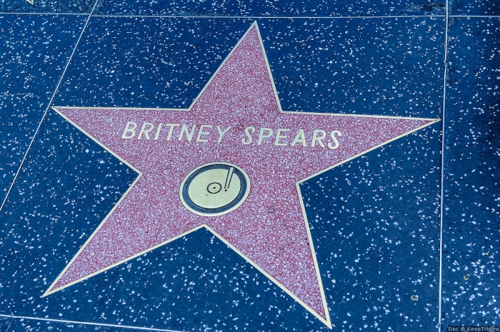

Slide 10
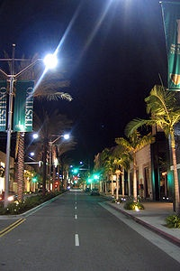
This is Beverly Hills
It is situated near Los Angeles. Most movie stars live here and they can feel safe: the Beverly Hills police are sure to turn up seconds after a call.

Slide 11
This is a huge shopping mall, called Hollywood and Highland. There is the Kodak Theatre, where the Oscars take place. Every year, usually in February, celebrities are sure to come for the most important event in show biz: Oscar Night. On that day the prestigious Academy Awards, called "the Oscars" are presented for year's best achievements in the film world.

Slide 12
Kodak Theatre
Is a part of Hollywood and Highland Centre. It has got 60 shops, 9 restaurants, 2 popular night clubs and 6 cinema halls of the Chinese Theatre. The Academy Awards are given every year by the US Academy of Motion Picture Arts and Sciences here.

Slide 13
One of the greatest events in Hollywood
is the annual presentation of Oscar, the legendary figurine which is the highest Award of the American Cinema Academy. Its aim is to further the development of cinematography.

Slide 14
Every year in February the American press publishes the titles of films
which have been chosen for the competition. On the presentation day there is a magnificent show in the Los Angeles Music Centre. Awards are given to the best actor, for the best script, for music, to the best actress .

Slide 15
Every 30 minutes there is an excursion about the theatre. For adults it costs 15 dollars. The walls of the hall are decorated with the fotos of the famous people – the winners of Oscar.

Slide 16
The Chinese Theatre
is situated on the Hollywood Boulevard. It has got 1162 seats. A lot of cinema – goers including stars like to watch films here. It has become a historical and cultural sight of Los Angeles.

Slide 17
Another tradition is the ceremony
of leaving one’s footprints or handprints on the pavement in front of the Chinese Theatre. Some actors consider it too pompous and do not accept the invitation for the ceremony.

Slide 18
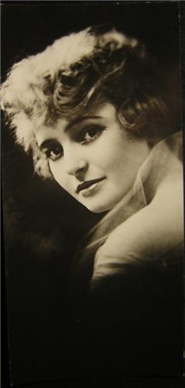
The first footprints left the star of the silent film – Norma Talmadge.

Slide 19
The footprints and the handprints of Marilyn Monro are the smallest.

Slide 20
Do you know any Russian films awarded Oscar? What are they? Who was the director of the film?
Russian films were awarded by Oscar too. The first Oscar was given to the documentary film by Vitali Suslenkov in 1942. Sergei Bondarchuk got Oscar in 1968 for the film “War and peace”. Then in 1975 was the film shot in corporation with Japanese director Akira Kurosava “Dersu Uzala. Vladimir Menshov - 1980 the film “Moscow doesn’t believe tears” Nikita Mikhalkov. In 1994 his picture “Burn by the Sun” was awarded by Oscar too. These directors brought honour to our country. It means that our films are worth seeing and we are proud of these outstanding people, who created such masterpieces. And at last in 2000 it was our cartoon “The old man and the sea” that won this award.

Slide 21
Sergei Bondarchuk got Oscar in 1968 for the film “War and peace”.

Slide 22
Vladimir Menshov got Oscar for the film “Moscow doesn’t believe tears” in 1980

Slide 23
In 1994 Nikita Mikhalkov’s picture “Burn by the Sun” was awarded by Oscar too.

Slide 24
And at last in 2000 it was our cartoon “The old man and the sea” that won this award. It was shot by producer Andrey Petrov from Yaroslavl.

Slide 25
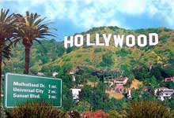
Quiz
1.Hollywood is
a. a suburb of LA. b. a city in California c. the name of a film studio.
2. Hollywood is
a. the capital of the USA. b. a world famous resort. c. the capital of world movie production.

Slide 26
3.Disney, Universal, Fox, Warner Bros, Paramount, Columbia and MGM are the names of
a. the most successful companies in the world. b. famous people. C. the largest film studios.
4. An Oscar is
a. a man's name b. the name of a famous film award. C. the name of a famous actor.

Slide 27
5. Most Hollywood stars live
a. in New York b. in or near LA. c. in Hollywood.
6. Beverly Hills is famous for
a. its architecture. B. the celebrity homes found there c. its restaurants and shops.

Slide 28
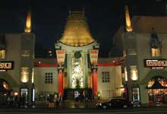
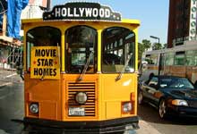
7. Hollywood Boulevard is famous for
A. its shops and restaurants. B. its movie theatres c. its film studios.

Slide 29
Answer the questions
a. Where is Hollywood situated?
b. Where is Los Angeles situated?
c. What is Hollywood famous for?
d. Where do most celebrities live?
e. Is Beverly Hills a city?
f. What is Malibu famous for?
g. Can you name the most important event in show biz?
h. What can you see on the Walk of Fame?

Slide 30
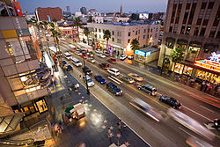
Thank you for your attention

